Slide 1
AI-SERVICE-for electric consumer market
Team members-
Tejas s koundinya
Sathwik C Gowda

Slide 2
Idea for the problem statement:
We propose a novel approach for this problem which involves combination of deep neural network model (VGG16 or RESNET) and user-interface such as (Website or APK), where the neural network would help us in the classification of electronic devices from an image uploaded by the user, which would be the first task of our processing. After gathering the information of the device which requires the attention, we find the professional who is best suited for the job and outsource the clints details to the professional and later after the inspection of the electronic device the professional must enter in the request of components required for the replacement.

Slide 3
Top-bottom Flowchart for steps in solving the problem statement: -
Image of the device must be uploaded
ex- bulb, fan, UPS or others
The classification of image is done
automatically w.r.t the brand associated
An request to professional expert w.r.t field
is done and also based on their reviews
The expert will be selected as per the
client's choise and will have an inspection of the component and provide a report
The bill is processed as per requirments and provided to the client

Slide 4
Tech used for model and web construction
Supervised model
Labeled data used custom-built
89 images took to train
InseptionV3 model used for development
99.9% accuracy reached
9 classes of devices are taken
User-interface developed with HTML-CSS-JS
Backend developed and storage from Python(flask API)-json

Slide 5
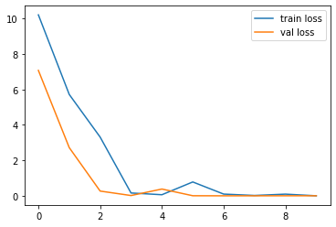
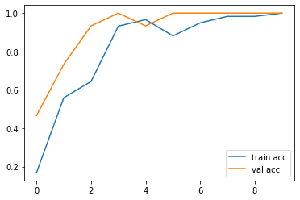
Training and testing model analysis

Slide 6
Link to the codes and dataset
Model - https://drive.google.com/file/d/1ca1YdMNj29A4ROhjjBy5mB7svDKcSsda/view?usp=sharing
Dataset – https://drive.google.com/drive/folders/1KMCMgJ7y74bkFqMh5HUkW0yh5XzSa18W?usp=sharing
Code – https://colab.research.google.com/drive/1GEPfaANuoJZM-wKxEBYRH2zvtKHVC5uF#scrollTo=MCKyvIxji2yw

Slide 7
Thank YOU!!!

